Slide 1

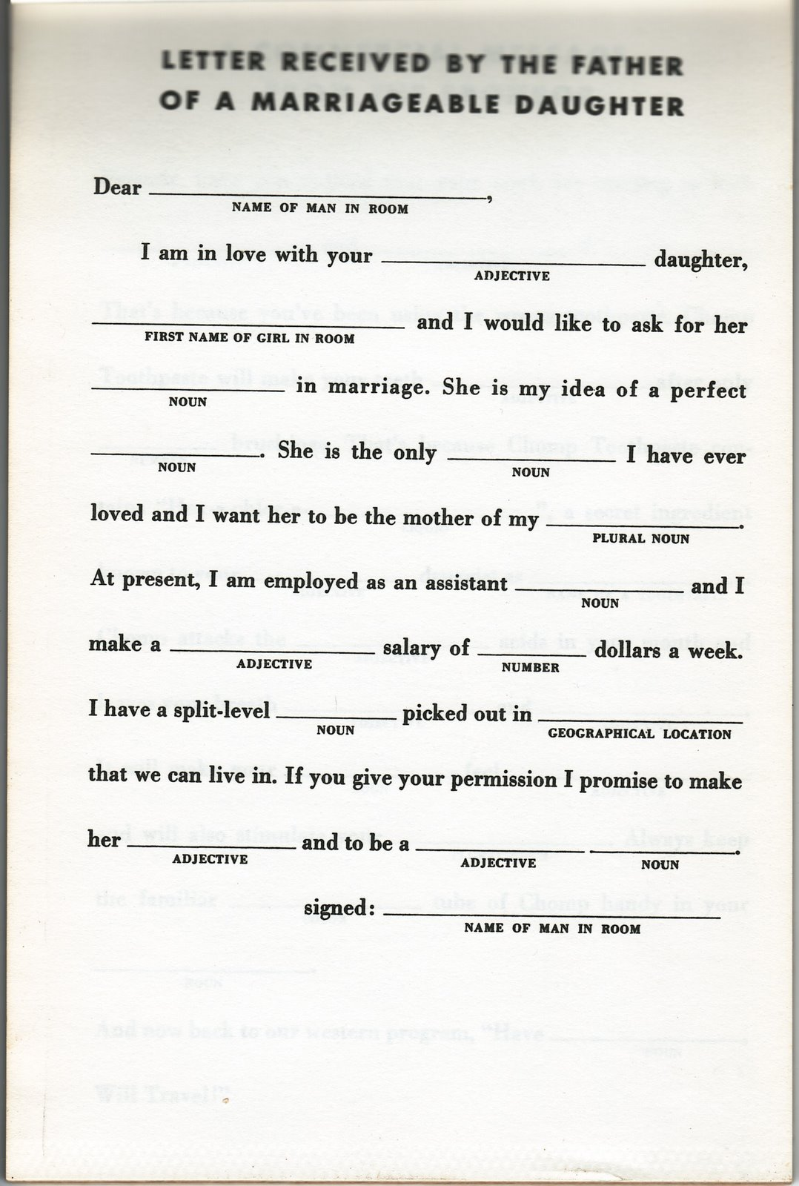
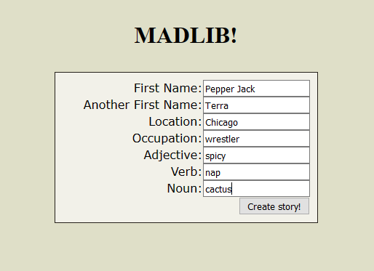

MADLIBS FUN
A game made up of words to create silly stories ☺
Project Coder: Amy Spruill
https://github.com/ksu-is/MadLib_Fun

Slide 2
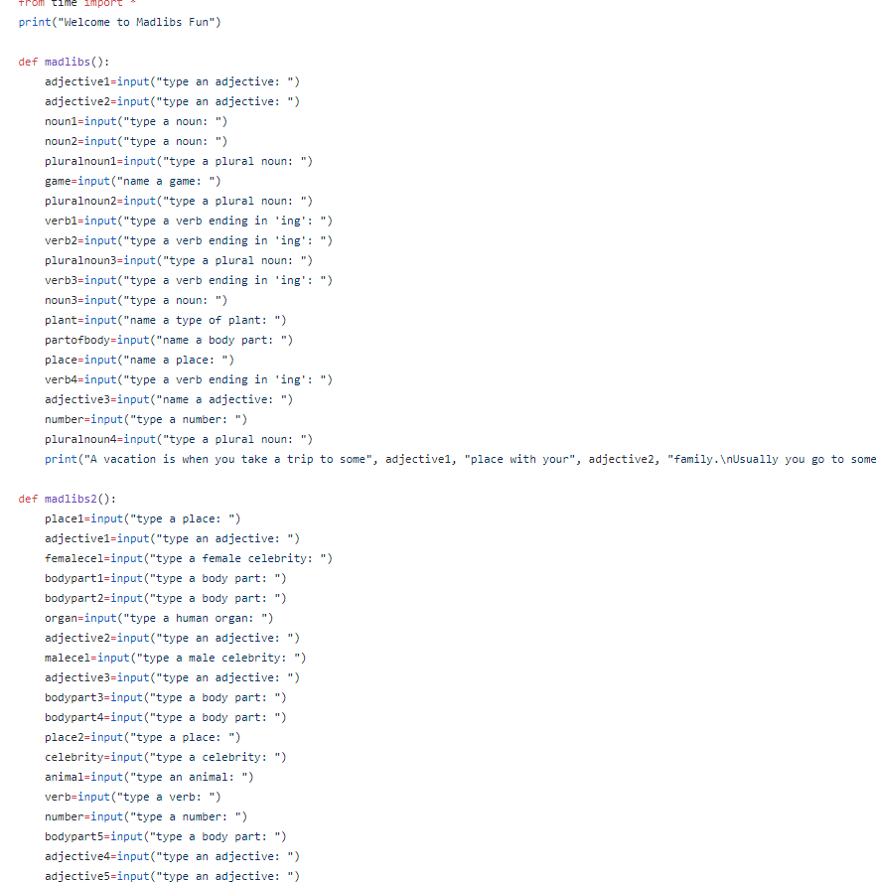
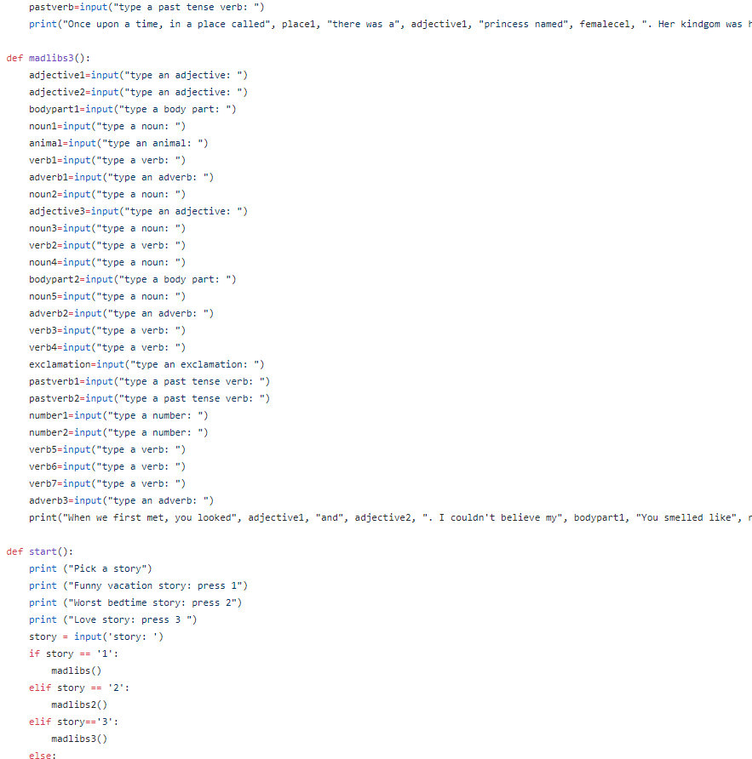
MADLIBS FUN

Slide 3
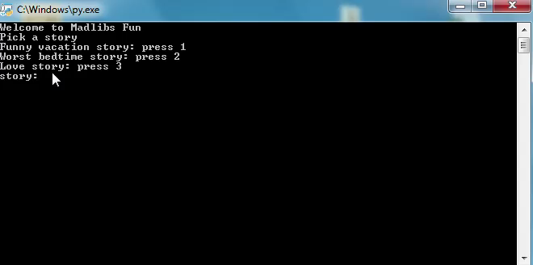
MADLIBS FUN

Slide 4
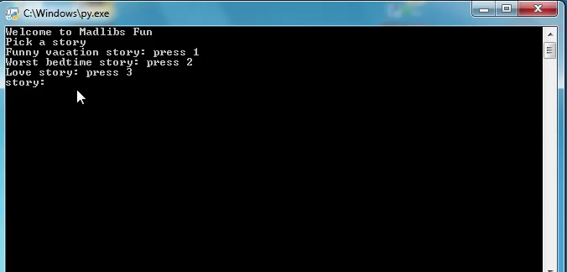
MADLIBS FUN

Slide 5
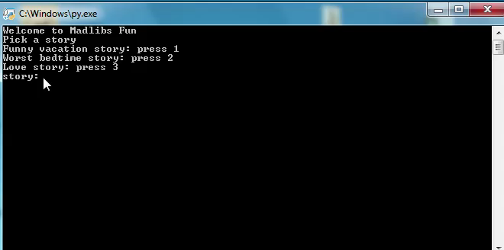
MADLIBS FUN

Slide 6
MADLIBS FUN
THE END

